Slide 1
PRESENTATION 8

Slide 2
Table of contents:
1- Cycle.
2- Fuel Cell.
3- Electrolyser.
4- Hydrogen Storage Problem
5- Battery.
6- Motor.
7- Wind Turbine
8- PV.
9- I Club Proposal.

Slide 3
Cycle.
1

Slide 4
FUEL CELLS

Slide 5
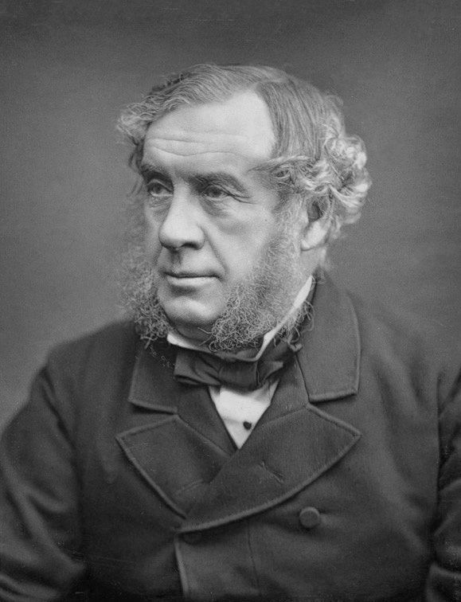
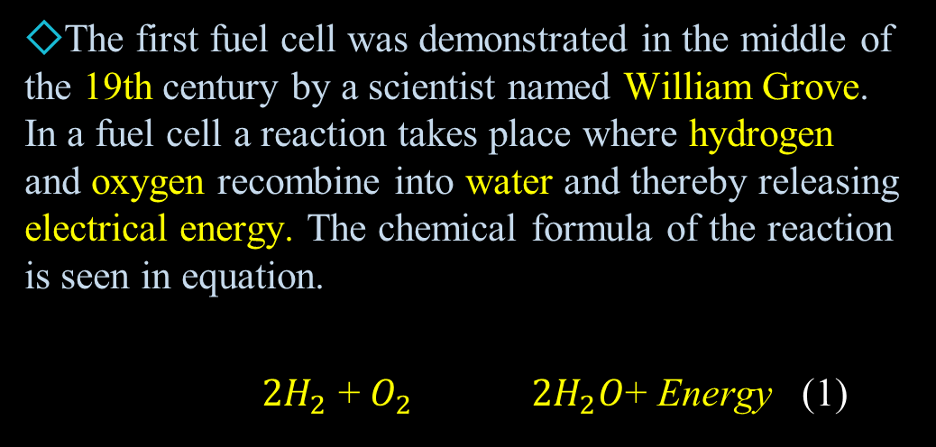
Introduction
The first fuel cell was demonstrated in the middle of the 19th century by a scientist named William Grove. In a fuel cell a reaction takes place where hydrogen and oxygen recombine into water and thereby releasing electrical energy. The chemical formula of the reaction is seen in equation.
${2H}_{2}$ + $O_{2}$ ${2H}_{2}O$+ Energy (1)

Slide 6
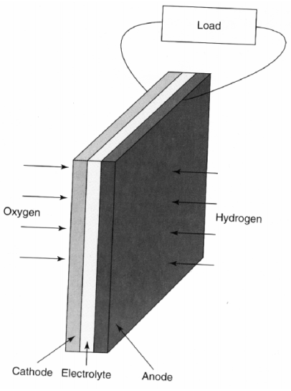
Basic structure of a fuel cell

Slide 7
A fuel cell consists of two electrodes, anode and cathode, with a layer of electrolyte between them.
The electrodes are normally made flat and porous to achieve good contact between the electrolyte and the gases.
The layer of electrolyte is made thin for the purpose to allow ions to pass through it.

Slide 8
FUEL CELL TYPES
1-Acid electrolyte fuel cell
2-Alkaline electrolyte fuel cell

Slide 9
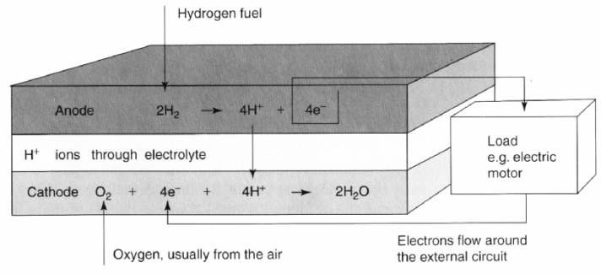
Acid electrolyte fuel cell

Slide 10
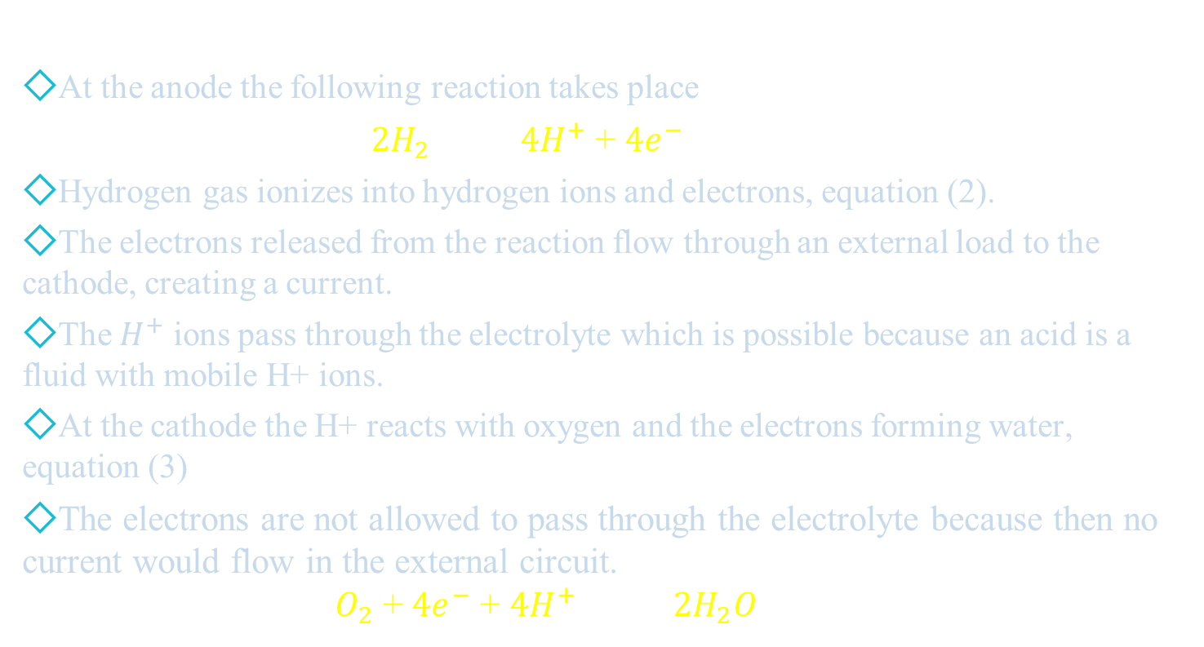
Acid electrolyte fuel cell
At the anode the following reaction takes place
$2H_{2}$ $4H^{+}$+ ${4e}^{−}$ (2)
Hydrogen gas ionizes into hydrogen ions and electrons, equation (2).
The electrons released from the reaction flow through an external load to the cathode, creating a current.
The $H^{+}$ ions pass through the electrolyte which is possible because an acid is a fluid with mobile H+ ions.
At the cathode the H+ reacts with oxygen and the electrons forming water, equation (3)
The electrons are not allowed to pass through the electrolyte because then no current would flow in the external circuit. $O_{2}$ + ${4e}^{−}$ + ${4H}^{+}$ ${ 2H}_{2}O$ (3)

Slide 11
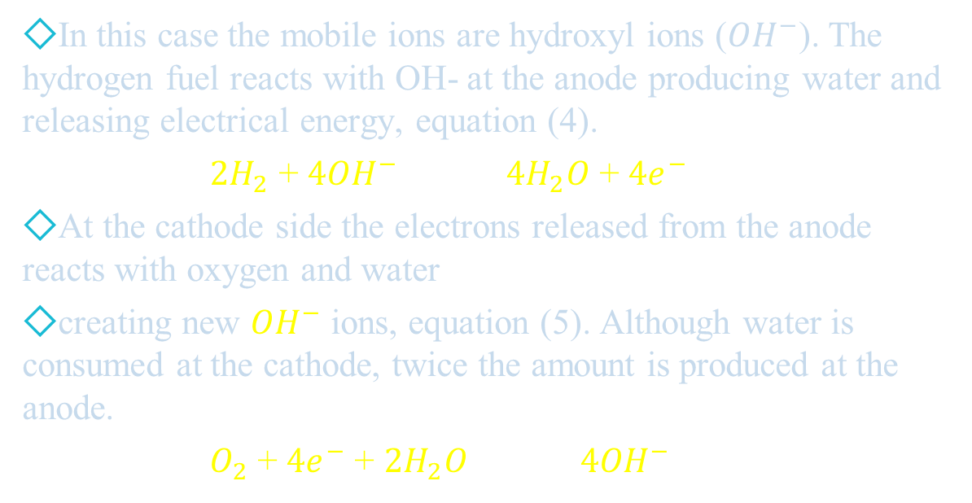
Alkaline electrolyte fuel cell
In this case the mobile ions are hydroxyl ions (${OH}^{−}$). The hydrogen fuel reacts with OH- at the anode producing water and releasing electrical energy, equation (4).
${2H}_{2}$ + ${4OH}^{−}$ ${4H}_{2}O$ + ${4e}^{−}$ (4)
At the cathode side the electrons released from the anode reacts with oxygen and water
creating new ${OH}^{−}$ ions, equation (5). Although water is consumed at the cathode, twice the amount is produced at the anode.
$O_{2}$ + ${4e}^{−}$ + ${2H}_{2}O {4OH}^{−}$ (5)

Slide 12
Proton exchange membrane fuel cell
The working temperature of these cells is quite low, around 30-100°C, which gives a problem of slow reaction rates but at the same time the startup is fast.
The problem of slow reaction rates is solved by the use of more effective electrodes and catalysts such as platinum
Another drawback is that the membrane is fragile and breaks easily. The field of application is essentially in vehicles, portable applications.

Slide 13
Fuel cell stack
1-Simple series connection 2-Bipolar series connection

Slide 14
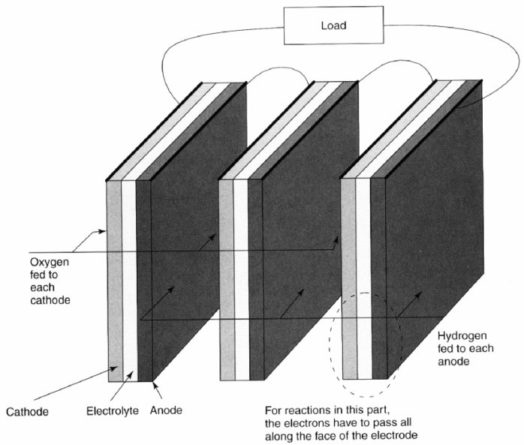
Simple series connection

Slide 15
A single fuel cell is made very thin for purposes stated before. This however limits the voltage across it.
A typical value for the voltage is about 0.7 V when drawing a useful current.
A higher voltage can be achieved by connecting several cells in series which is known as a stack.
The easiest way of doing this is to connect the edge of the anode to the cathode of the next cell, With this configuration the electrons have to travel across the surface of the electrode to the edge.
Even if the electrodes are good conductors there will be a voltage drop. This drop will be substantial in comparison to the low cell voltage and therefore this method is not used unless the current is very small.

Slide 16
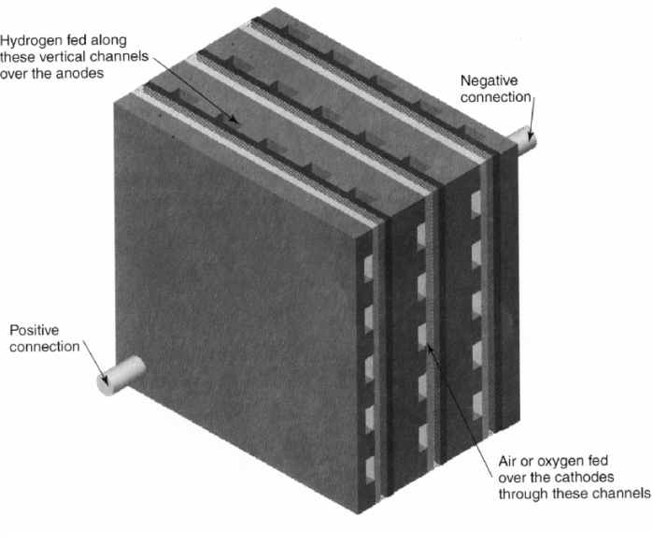
Bipolar series connection

Slide 17
A better solution for the construction of a stack is to make the connections with bipolar plates made from materials with good conductivity such as graphite or stainless steel.
These plates make connections all over one cathode to the anode of the next cell, hence bipolar.
The conditions that they must fulfill are that there has to be a good electric connection between the electrodes and that the different gases must be separated. In the bipolar plates there are normally horizontal channels used to feed oxygen to the cathode and vertical channels to feed hydrogen to the anode
When assembling the stack with bipolar plates a solid block is formed where the current flows more or less straight through the cells instead of across the surface, resulting in better efficiency. The block also becomes more robust and strong due to that the electrodes are better.

Slide 18
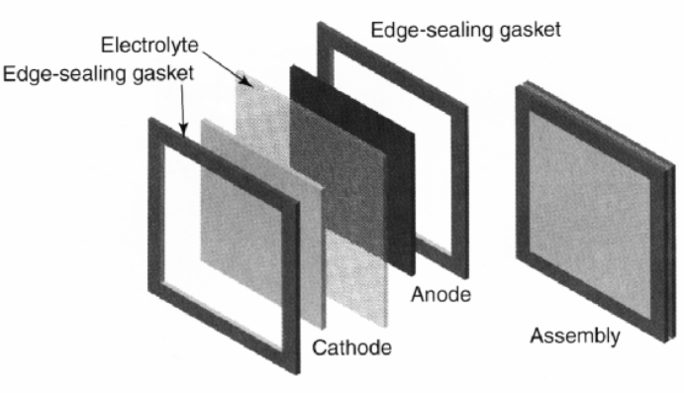
Structure of a fuel cell with edge seals to prevent leakage of the gas at the edges of the electrodes

Slide 19
In reality, when designing a stack with bipolar plates further considerations have to be done.
The difficulties include supply and leakage of the gases. As mentioned before the electrodes are made porous to allow the gas to pass through it.
A result of this is that the gas can leak out of the edges of the electrodes. The solution to this problem is to seal the edges. This is done by making the electrodes smaller than the electrolyte and then fitting a sealing gasket around them.

Slide 20
When supplying fuel and oxygen to a fuel cell stack, where the edges of the electrodes are sealed, four manifolds, one at each side, are used.
Because of the seals the hydrogen fed vertically only comes in contact with the anodes and the oxygen fed horizontally only comes in contact with the cathodes.
The main advantage is the simplicity of it. However
There are two important disadvantages. The first one is the problem regarding the cooling of the system. It is difficult to supply some kind of extra cooling and therefore the cells have to be cooled using the air passing through the cathodes. This leads to that the air has to be supplied at a higher rate than necessary. In some cases this is enough to cool the cells but energy is wasted.
The second disadvantage concerns the gasket around the edges of the electrode. At the points where there is a channel it is not pressed down evenly which can cause a leakage of the gases .

Slide 21
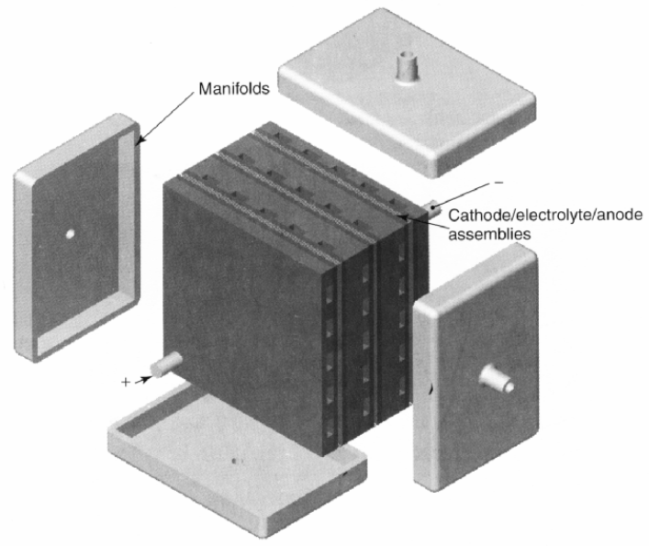
Fuel cell stack with external manifolding.

Slide 22
Advantages and Drawbacks

Slide 23
Advantages
Low emissions
More efficient compared to a conventional internal combustion engine
Simplicity, few if any moving parts
Reliable and long lasting system
Silent

Slide 24
Drawbacks
Lifetime
Cost
Hydrogen has to be produced.
Not yet available infrastructure for hydrogen .

Slide 25
Fuel Cell Model
INPUT
Required Power
Required Voltage
Fuel Cell Specifications:
Operating Temperature (T)
Gibbs free energy value (G)
Hydrogen & Air Pressures in atm
Internal Resistance (r)
Charge Transfer Coefficient(α)
Amplification Constant(α₁)
Exchange Current density(i₀)
Limiting Current Density(i_{L})
Mass Transport Constant (K)
OUTPUT
No of Cells (N) Cell Area (A) Current (I) Polarization Curve Power Curve

Slide 26
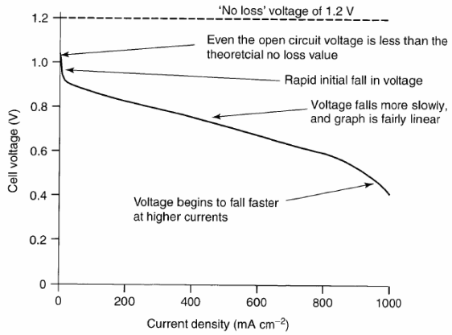
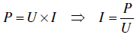
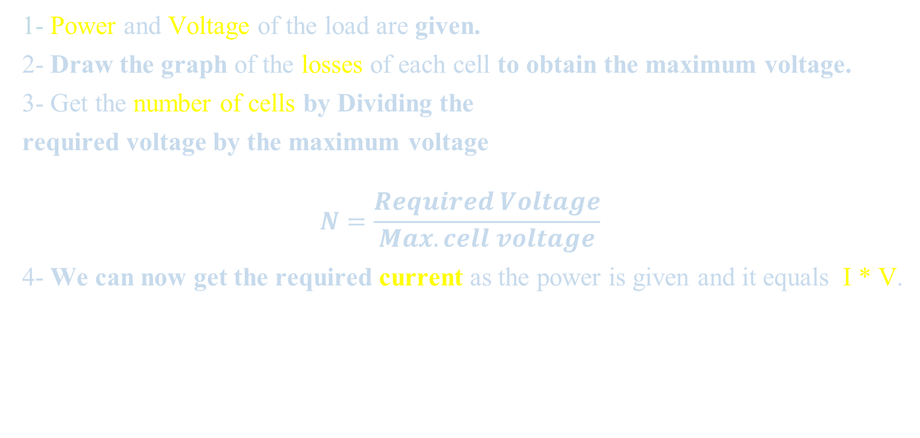
Design Procedures
1- Power and Voltage of the load are given.
2- Draw the graph of the losses of each cell to obtain the maximum voltage.
3- Get the number of cells by Dividing the
required voltage by the maximum voltage $$N=\frac{Required Voltage}{Max. cell voltage}$$
4- We can now get the required current as the power is given and it equals I * V.

Slide 27
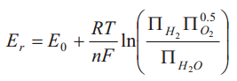
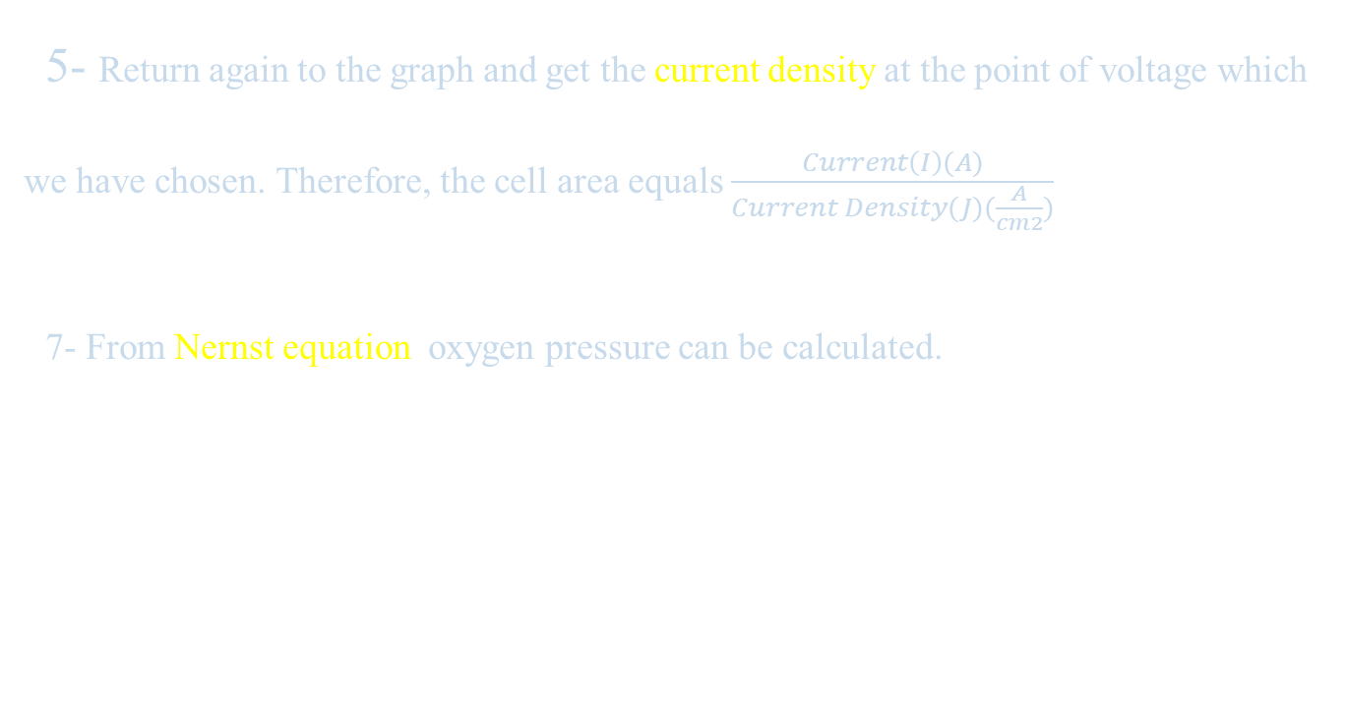
Design Procedures
5- Return again to the graph and get the current density at the point of voltage which we have chosen. Therefore, the cell area equals $\frac{Current\left(I\right)(A)}{Current Density(J)(\frac{A}{cm2})}$
7- From Nernst equation oxygen pressure can be calculated.

Slide 28
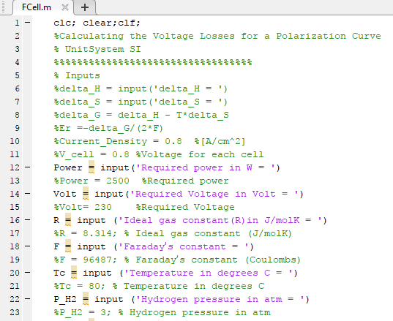
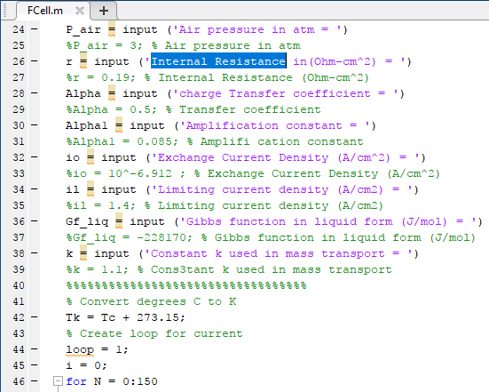
MATLAB CODE

Slide 29
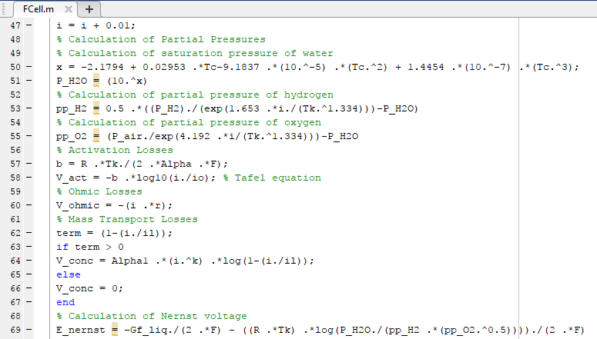
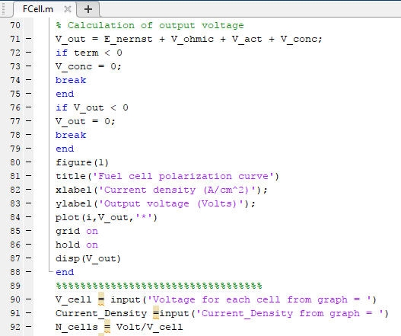
MATLAB CODE

Slide 30
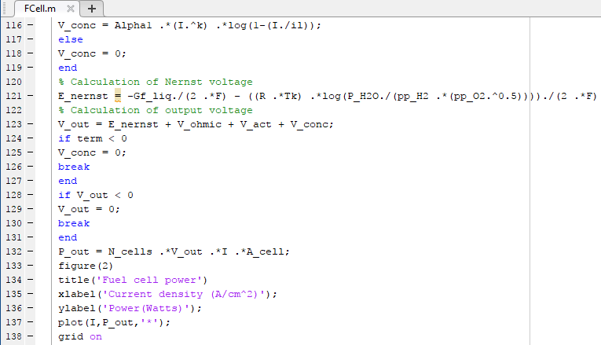
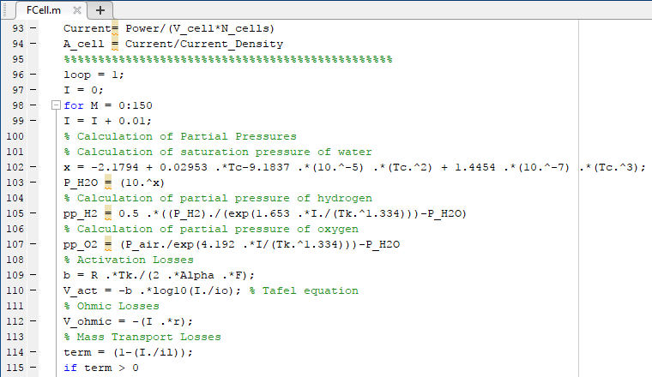

MATLAB CODE

Slide 31
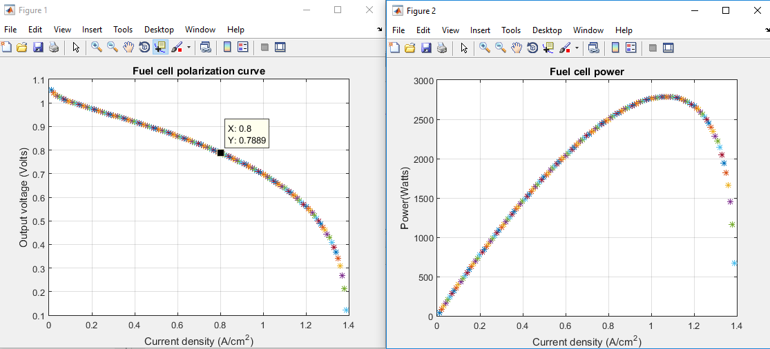
MATLAB CODE
Output Performance Curves

Slide 32
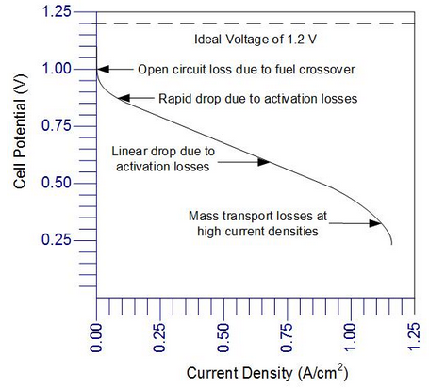
There are three distinct regions of a fuel cell polarization curve :
At low power densities, the cell potential drops as a result of the activation polarization.
At moderate current densities, the cell potential decreases linearly with current due to ohmic losses.
At high current densities, the cell potential drop departs from the linear relationship with current density as a result of a more pronounced concentration polarization.

Slide 33
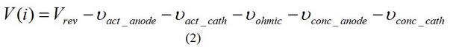
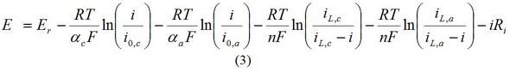
Therefore, the operating voltage of the cell can be represented as the departure from ideal voltage caused by these polarizations:
Where V_act ,V_ohmic and V_conc represent activation, ohmic (resistive), and mass concentration polarization. As seen in equation 2, activation and concentration polarization occurs at both the anode and cathode, while the resistive polarization represents ohmic losses throughout the fuel cell
A relationship between the fuel cell potential and current density (fuel cell polarization curve) is:

Slide 34
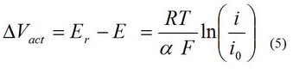
Activation Polarization: Voltage Loss Due to Voltage Overpotential
Activation polarization is the voltage overpotential required to overcome the activation energy of the electrochemical reaction on the catalytic surface. The catalyst reduces the height of the activation barrier, but a loss in voltage remains due to the slow oxygen reaction. The total activation polarization overpotential is 0.1 to 0.2 V, which reduces the maximum potential to less than 1.0 V even under open-circuit conditions. Activation overpotential expressions can be derived from the Butler-Volmer equation. The activation overpotential increases with current density and can be expressed as:
where i is the current density, and i₀, is the reaction exchange current density. Exchange current density represents the reaction rate.

Slide 35
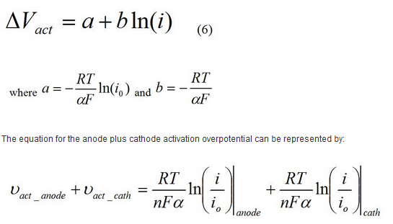
Activation Polarization: Voltage Loss Due to Voltage Overpotential
Tafel Equation:
where n is the number of exchange protons per mole of reactant, F is Faraday’s constant and α is the charge transfer coefficient used to describe the amount of electrical energy applied to change the rate of the electrochemical reaction. The exchange current density, i_{o} is the electrode activity for a particular reaction at equilibrium.
Notes:
In PEMFC, the anode i_{o} for hydrogen oxidation is very high compared to the cathode i_{o} for oxygen reduction, therefore, the cathode contribution to this polarization is often neglected

Slide 36
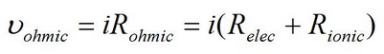
Ohmic Polarization: Voltage Loss Due to Charge Transport
This phenomenon is called “ohmic polarization,” and it occurs because of the electrical resistance in the cell components. The cell components that contribute to the electrical resistance are the electrolyte, the catalyst layer, the gas diffusion layer, bipolar plates, interface contacts and terminal connections. The reduction in voltage is dominated by internal ohmic losses through the fuel cell. This voltage loss is called “ohmic loss,” and includes the electronic (R_{elec}) and ionic (R_{ionic}) contributions to fuel cell resistance. This can be written as:
Notes:
R_{ionic} dominates the reaction in equation 8 since ionic transport is more difficult than electronic charge transport. R_{ionic} is the ionic resistance of the electrolyte, and R_{elec} includes the electrical resistance of bipolar plates, cell interconnects, contacts, and other cell components through which electrons flow.

Slide 37
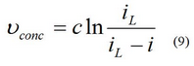
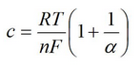
Concentration Polarization: Voltage Loss Due to Mass Transport
A fuel cell must continuously be supplied with fuel and oxidant to produce electricity. Products must also be continuously removed to have maximum fuel cell efficiency. The study of mass transfer of uncharged species is important because it can lead to significant fuel cell performance losses if not understood properly. The reactant and product concentrations within the catalyst layer determine the fuel cell performance. Concentration loss can be minimized by optimizing the mass transport in the fuel cell electrodes and flow structures.
Concentration Polarization can be expressed by the following equation:
Notes:
The mass transport in the fuel cell electrodes/fuel structures is dominated by convection and the laws of fluid dynamics since the flow channels are macroscale (usually in millimeters or centimeters). The mass transport of the fuel cell electrodes occur on a microscale and are dominated by diffusion. A standard way of calculating fuel cell concentration loss (or mass transport loss).
Actual fuel cell behavior frequently has a larger value than what the equation predicts. Due to this, c is often obtained empirically. The concentration loss appears at high current density and is severe. Significant concentration loss limits fuel cell performance

Slide 38
ELECTROLYZER
3

Slide 39
PEM Electrolyzer
PEM is able to make use of fluctuating power supply from the renewable and result of fuel hydrogen due to the solid structure of the electrolyte (it is easy and more efficient)
PEM electrolyzer offers an efficient ,flexible and practically for high quality of hydrogen production
In recent time more attention Is being paid to PEM electrolyzer due to its offers several advantages compared other method of electrolyser in term of smaller mass volume characteristic ,higher in current densities ,high degree of gas purity and better safety level .

Slide 40
Mode of operation of (PEM)
The dissociation of water into hydrogen and oxygen is relatively high since water molecules have a stable structure at ambient temperature.
A minimum potential of 1.23 V is applied across the electrochemical cell to initiate electrochemical reactions at both anode and cathode electrodes
Water is introduced at the anode and dissociated into oxygen,protons and electrons via the following reaction
Anode =H₂O→ .5 O₂ +2H⁺+2e⁻ ⁽¹⁾

Slide 41
Mode of operation of (PEM)
The hydrogen ions are driven through the membrane to the cathode under an electric field where they combine with the electrons arriving from the external circuit to form hydrogen gas
Cathode = 2H⁺+ 2e⁻ →H₂ ₍₂₎
The net reaction for the entire cell is
H₂O (leq)→ H_{2(g)}+ .5 O_{2(g) (3)}

Slide 42
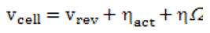
Operating cell voltage
The single operating cell voltage of PEM electrolyzer is given by the summation of the reversible voltage and the other different over potentials
(4)

Slide 43
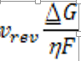
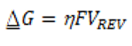
Reversible voltage
Each reaction of the electrode depends on the reaction of water at minimum voltage which corresponds to the reversible potential ,this can determined by using the Gibbs free energy equation
(5) (6)
⍙G :is the Gibbs free energy of 237.17 8 KJ/K.mole(also known as the lower heating value ,(LHV) )
Vrev : is the reversible voltage
η:is the number of the electrons
F: is the Farady’s constant

Slide 44
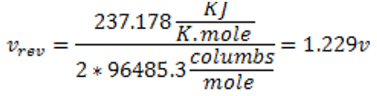
Reversible voltage
Since all variable in equation (6) is already known ,the value of the reversible voltage of the cell can be calculated as
(7)

Slide 45
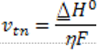
Thermo neutral voltage
In thermodynamics of electrolysis , since the Gibbs free energy is known as the maximum amount of usable electrical energy availble when the hydrogen recombines with the oxygen
It can be identified as the amount of the energy losses in the electrolysis system and can be expressed as follow
(8)

Slide 46
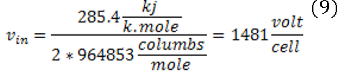
Thermo neutral voltage
Where ⍙H° is the high heating value (HHV) of 285.84 J/K.mole
The value of thermo neutral voltage can be clarified
Since the value of thermoneutral voltage is the amount of energy losses in the cell .it will not include in eq(4) to find the cell voltage values

Slide 47
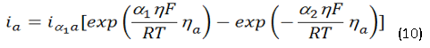
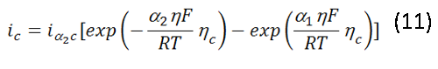
Activation overvoltage
By relating the butler-volmer expression , the current density at the anode and cathode can be expressed in terms of charge transference phenomena and exchange current dinesty
The current density at the anode
The current density at the cathode
R is the universal gas constant , R = 8.314 J/mol.k
T is the variable temperature
α1 and α2 is the symmetry factor at anode represents an additional energy fraction of the reduction and cathode represent the oxidation
η is the number of electrons involved

Slide 48
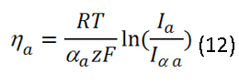
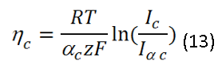
Activation overvoltage
Moreover , the activation over potentials at anode and the cathode can be inscribed as
(Where Z is the stoichiomrtric coefficient of the number of the electrons involved
αa and αc are the charge transfer coefficients
There values are 0.5 on the symmetry reactions
The value of the stoichiometric coeficient is 2 since it was water electrolysis

Slide 49
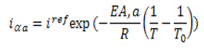
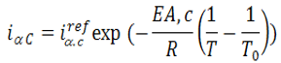
Activation overvoltage
The value of the exchange current density of anode , iα.a and cathode iα.c can give a very big impact on the activation over potenial values on both sides . By expressing the Arrhenius equations the value of each exchange current density at anode and cathode can be identified using these equations
(14) (15)

Slide 50
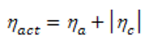
Activation overvoltage
Where T0 (k) is the reference temperature
EA,a and EA,c are the anodic and cathodic active energy (J/mol)
iα.a and iα.c is the anodic and the cathodic reference exchange current density at reference temperature
The role of activation over potenial can be derived as
(16)

Slide 51
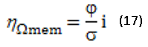
Ohmic overvoltage
The ohmic over protential can be classified into two categories :
Ohmic over potenial due to membrane resistance
This is caused by the membrane resistance to the flow of ions it also called voltage drop due to membrane resistance to the flow of ions
(17)

Slide 52
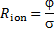
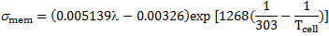
Ohmic overvoltage
Where is an ionic resistance as a function of membrane thickness conductivity
ϕ is the membrane height (cm)
is the local ionic conductivity with water content and temperature function
Where λ is the degree of membrane humidification

Slide 53
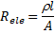
Ohmic overvoltage
Ohmic overpotrnial due to membrane resistance (ionic resistance)
This is caused by electronic materials such as bipolar plates electrodes current collectors
The interfacial resistance can be expressed as
(19)
The ohmic resistance of the electronic materials is
(20)
Where ρ is the material resistivity , l is the length of the electrons path and A is the conductor cross-sectional area

Slide 54
Ohmic overvoltage
The ohmic overpotenial due to electronic and ionic resistance is
(21)

Slide 55
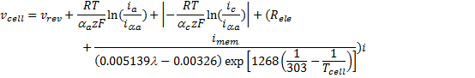
Diffusion overvoltage
The diffusion give a function in overcoming the energy lost presume in the cell due to the mass transport resistance of electrochemical reaction in the interface of the membrane and electrode ,considerring the value of the diffusions result , it can be neglected .Finally from E.Q (4) the overall operating cell voltage can be concluded as : (22)

Slide 56
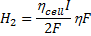
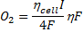
Molar flow rate
Is known that the current ,I can be found using
I = iA (23)
where I is the current density and A is the electrode area
By governing the Faraday’s law in the electrochemical cell ,The molar flow rate can be written as
(24) (25)

Slide 57

Molar flow rate
the number of electrolytic cells used only one cell ,
=1 (26)
while I is the overall current across the cell
The Faraday’s efficiency ηf ,I the differential between the experimental and theoretical hydrogen flow rate .it can be assumed as 100% since many other literatures agreed that it has the value over 95%

Slide 58



Molar flow rate
Since this was explained it can be simplified to be
(27)
(28)
(29)

Slide 59


Molar flow rate
The hydrogen production can be expressed in terms of volume flow rate
(30)
The hydrogen volume flow rate can be converted to L/min as shown below
(31)

Slide 60
Parameter affecting the operation
The effect of the operating parameters such as current density ,exchange current density ,ohmic overvoltage and activation over potenial on the operating cell voltage have been discussed include the effect of temperature on the ohmic resistance
The hydrogen volume flow rate was analyzed within a range of given current density 0.1-2.0A/Cm²
There are two cases that would affect the result ,one is the temperature and the current density
And the second one is the relation between the current density and the exchange current density

Slide 61
conclusion
The mathematical model for simple PEM electrolyzer has been developed based on a combination of fundamental thermodynamic and electrochemical relationship
Different operating conditions such as exchange current density ,temperature and current density have been analyzed for optimized hydrogen production of polymer electrolyte membrane electrolyzer system
It can be concluded that when the operating temperature of the electrolyzer system increases the ohmic resistance decreases.And this leads to increase in ionic conductivity in the membrane.
Therefore in order to increase the hydrogen flow rate
It is important to operate the electrolyzer system at the relatively high temperature

Slide 62
Hydrogen Storage Problem.
4
The key for advancing hydrogen & fuel cell technologies

Slide 63

1. Introduction
We all know that Hydrogen is a great candidate for being the fuel of the future, for many reasons:
1- The most abundant element in the universe (75%)
2- Clean fuel (producing only water vapor when burned)
3- Can be produced by several methods.
4- Hydrogen has the highest energy to mass ratio between all fuels.

Slide 64


1. Introduction
To put that in perspective:
A
B
500 km
We need 5 kg of hydrogen
Which is 1/3 of the mass of gasoline needed for the same trip.
However this amount of hydrogen at room temperature and pressure has a volume of 60 $m^{3}$

Slide 65


1. Introduction
Unfortunately hydrogen fuel has many drawbacks:
1- Not readily available (must be paid for)
2- Safety problems, due to its high flammability
3- Low critical temperature (33 K) and boiling point (20 K)
4- Low density (70.8 kg/$m^{3}$ at liquid state)
(0.0899 g/L at 0ºC for gaseous state)
5- Storage issues

Slide 66


2. Hydrogen Production
There are many sources to produce hydrogen:
1- Electrolysis (dissociation of water)
2- Steam reforming (methane + steam = hydrogen + ${CO}_{2}$)
3- Thermolysis (decomposition with heat at 2000ºC)
4- Separation membrane.

Slide 67

3.1. Storage methods
Multiple methods have been proposed to store hydrogen:
1- High pressure gas cylinders.
2- Liquefying the hydrogen gas (T<33 K + 13.3 atm)
3- Absorbing hydrogen on materials with large surface area.
4- Metal hydrides
5- Using reactive metals with water.
The most common method is pressurized cylinders.

Slide 68
3.2. Hydrogen Cylinder
Hydrogen
Tank
Electrolyser
210 w, 4 bar,
1 L/min
Fuel Cell
500 w, 0.5 bar, 6.5 L/min

Slide 69


3.3. Metal hydrides
Metal hydrides are metals which have been bonded to hydrogen to form a new compound, they release hydrogen gas when heated:

Slide 70

3.4. Reactive metals
Reactive metals are: Lithium, Magnesium, Aluminum, Zinc
Li-OH
reduction
Li
Li
Water
$$H_{2}$$
Comb
Water

Slide 71

4. Cella Energy
Cella Energy is an advanced materials and technologies company with first-mover advantage in safe, lightweight, high performance hydrogen storage technology. Cella specializes in advanced hydrogen storage material capable of storing up to 1 liter of hydrogen per gram.

Slide 72






4. Cella Energy
Material of the pellet:
Ammonia-borane (${NH}_{3}{BH}_{3}$)
12-14% of usable $H_{2}$ by weight
${NH}_{3}{BH}_{3}→{NH}_{2}{BH}_{2}+H_{2}$ 80-110 ºC
${NH}_{2}{BH}_{2}→NHBH+H_{2}$ 110-180 ºC

Slide 73

5. Chicken Feathers
Chicken feathers become a highly absorbent material for hydrogen gas (at ambient temperature and pressure) when heated to 750°C, because its microscopic structure become very large in surface area.

Slide 74
BATTERY
5

Slide 75
Battery Function
The battery has two main functions within this electrical circuit:
Guarantee a minimal autonomy according to the testing requirements.
Act as a buffer to supply power when the power sources are unable to meet the demand from the motors and to level current peaks.

Slide 76
Battery Types
Rechargeable Batteries
Lead acid
flooded
MNC
Li ion
sealed
LFP

Slide 77



Lead acid types
Flooded
Sealed lead acid
AGM
GEL

Slide 78
Lead acid types
Flooded lead acid batteries require three things that VRLA don’t:
Upright orientation to prevent electrolyte leakage.
Ventilated environment to diffuse gases created during cycling.
Routine maintenance of electrolyte
Due to these differences, the lower cost of flooded lead acid must be balanced against the added complexity and secondary costs.

Slide 79
Lead acid types
AGM: a glass matrix is used to contain the liquid electrolyte.
GEL: a thickening agent is added to turn the electrolyte from liquid to gel

Slide 80

Comparison of Battery Technologies

Slide 81


Slide 82
Li ion battery
Advantages :
Light and small battery
High voltage, good specific capacity, good lifetime
Disadvantages:
More expensive than lead acid battery
Needs circuit breaker to avoid fire when (over charging or discharging)

Slide 83
Lead acid battery
Advantages :
Relatively cheap to manufacture.
High tolerance of over charging or discharging.
Disadvantages:
Low energy density and specific energy density
Fails after a few years use lifespan
Lead is not environmentally friendly

Slide 84


Design Procedures for lead acid
Calculating load
Days of Autonomy
Depth of discharge
Temperature factor
Nominal battery voltage

Slide 85

MATLAB Code

Slide 86


Results
MATLAB
CASE

Slide 87
PROPULSION SYSTEM (MOTOR)
6

Slide 88
INTRODUCTION
We should know that Our Lab Model Propulsion system completely different from Ships Propulsion Systems. (in Size, Function and Components )
We will discuss quickly Ships Propulsion Systems Types then begin with our Model System.

Slide 89
INTRODUCTION
Today ship propulsion is not just about successful movement of the ship in the water. It also includes using the best mode of propulsion to ensure a better safety standard for the marine ecosystem along with cost efficiency.

Slide 90






SHIPS PROPULSION SYSTEM TYPES
Diesel Propulsion
Wind Propulsion
Nuclear Propulsion
Gas Turbine Propulsion
Biodiesel Fuel Propulsion
Steam Turbine Propulsion
Diesel-Electric Propulsion - ABB XO2100
Water-Jet Propulsion

Slide 91



SHIPS PROPULSION SYSTEM TYPES
Gas fuel or Tri Fuel Propulsion
Solar Propulsion
Fuel Cell Propulsion

Slide 92
LAB MODEL PROPULSION SYSTEM (MOTOR + PROPELLER)
Cause the sizing we made on the Ship demand Power, Size and volume of the Model, Main Voltage for our Circuit and aim of our Model(Educational) , We will use different System with Simple Components.
We will use Fuel Cell Propulsion system with Simple Electric Motor

Slide 93

THE MOTOR
There are Two main types of DC Motors
1- Brushed DC Motors
2- Brushless DC Motor
The Suitable one of them for our application is Brushless DC Motor … Why?!!

Slide 94
BRUSHLESS DC (BLDC)
The Brushless DC (BLDC) motor is the ideal choice for applications that require high reliability, high efficiency, and high power-to-volume ratio.
Generally speaking, a BLDC motor is considered to be a high performance motor that is capable of providing large amounts of torque over a vast speed range.
Brushless DC Motor is better that brushed mainly in Cost, Expected life and maintenance.

Slide 95
SELECTION OF OUR BLDC MOTOR
What we need to begin to select our suitable BLDC Motor
1- Total Resistance (Required Torque) (Rt)
2- Max Speed Required (V)
3- Main Voltage of our Circuit
To Get the Mechanical Power Demand must be > Total Resistance
Power = Rt X V

Slide 96
SELECTION OF OUR BLDC MOTOR
After know those data we can make a market study for available BLDC Motors and Select suitable One with Min. Specifications
Vmax >= Our Circuit Volt
Pmax >= Required Power
We should try to work within Max. eff. To safe buttery life

Slide 97

Volt
Propeller
Current
Power
RPM
Efficiency

Slide 98
SELECTION OF OUR BLDC MOTOR
Matlab Code to get any Motor Curves
Speed & Torque curve
Efficiency & Torque curve

Slide 99



SELECTION OF OUR BLDC MOTOR

Slide 100
WHAT IS NEXT ?!
We will work on Matlab Coding More to get the final code of Selection the suitable characteristics to go by it through market and get the most available and efficient Motor
Make a Simulink for Motor and ESC (Speed Controller).
(Propulsion System)

Slide 101
Wind Turbines
7

Slide 102
Wind Turbine Power: The Betz Limit and Beyond
One-dimensional fluid dynamics models
In this section, one-dimensional fluid dynamics models are analyzed and formulated based
on the extended Bernoulli equation , accounting for losses that are assumed to be proportional to the square of the velocity of the air crossing the rotor blades of the wind turbine.
The performance characteristics of the wind turbine are given by the power and thrust coefficients.
The efficiency of the wind turbine is addressed and its relation to the power coefficient is discussed. While developing a model to describe the performance of a wind turbine, common assumptions
regarding the fluid flow are as follows :
1. The entire field is one-dimensional.
2. The fluid considered is not compressible.
3. The flow field in the proximity of the turbine is a pure axial flow.
Other assumptions are given for the specific models.

Slide 103

1.1. Bare wind turbine
Consider a wind turbine that intercepts the flow of air moving with velocity V0. The different quantities involved in the physics of the moving air are the pressure, p, the velocity, V, the cross section area, A (at different locations along the stream lines), and the thrust on the blades of wind turbine, T. The upstream condition is identified with a subscript of zero, the
downstream condition is identified with a subscript of 3, and the turbine locations are identified by subscripts of 1, 2, and t (see Figure 1).

Slide 104
Schematics of the bare wind turbine. In the upper part, airstream lines are shown crossing the turbine's rotor.
The velocity of the air at the rotor is the same based on the mass flow rate: V1=V2=Vt. The pressure drop is determined
by Δp=p1-p2

Slide 105


The steady state mass flow rate is given by:
The modified Bernoulli equation (with reference to the turbine head), which describes the energy balance through the wind turbine, is written between the entrance and exit sections, and is given by:

Slide 106

In this equation ht is the head of the turbine (related to the amount of power extraction)
h_loss represents the head losses, and γ is the specific weight. The loss term in the energy equation accounts for friction (mechanical and fluid) and is assumed proportional to the kinetic energy of the rotor blades, expressed as follows:

Slide 107


Equations (2) and (3) are rearranged and the head of the turbine is given by:
The power output from the turbine, P, is given by:

Slide 108


From equation (5) we can determine the power coefficient, CP, by:
The developed thrust, T, on the turbine blades is given by the linear moment equation (see [15] for more details), as follows:

Slide 109


The thrust coefficient, CT, based on equation (7), is given by
Equations (5) and (7) are governed by the following relationship:

Slide 110

By observation, the velocity of air decreases toward the downstream. Therefore, we can simplify calculations by introducing the parameter,
“a“ to express the velocity at the cross section of the turbine, and the upstream velocity can be determined by:

Slide 111


Equating equations (5) and (9) gives the velocity of the air, V3, at the downstream, and after some algebraic manipulation, it could be shown to be given by:
The normalized loss coefficient is defined by:

Slide 112

Equations (11) and (12) are useful to calculate the power coefficient (equation (6)) and the thrust coefficient (equation (8)).
For the case where the losses are negligible, the known results in the literature are reproduced and given by the following equations:
The downstream velocity is given by:

Slide 113



The power coefficient is given by:
The thrust coefficient is given by:
Inversing the relation given in equation (15), the parameter, a, is given as a function of “CT” by:

Slide 114

Finally, the power coefficient as a function of the thrust coefficient is given by:

Slide 115

Wind turbine efficiency
Usually, efficiency is defined as the ratio between two terms: the amount of net work, w, to the input, q_in, energy to the device.
Efficiency can be alternatively defined as the ratio between the derived power, Pout, and the rate of energy flowing to the system, Pin. Based on these definitions, the efficiency of power generating machine is given by:

Slide 116
Betz-Efficiency
As was observed by Betz, the maximal achievable efficiency of the bare wind turbine is given by the Betz number
B = “16/27” = 59.259
the power coefficient of the bare turbine was considered under the assumption of frictional losses. In this case, the power coefficient can
also be identified as the efficiency of the wind turbine in this case.

Slide 117
Why 3 Blades are the most efficient ?!!
https://interestingengineering.com/video/ever-wondered-wind-turbines-3-blades

Slide 118
Wind assist propulsion systems

Slide 119
Definition
Wind assisted propulsion is the practice of decreasing the fuel consumption of a merchant vessel through the use of sails or some other wind capture device.
Sails used to be the primary means of propelling ships, but with the advent of the steam engine and the diesel engine, sails came to be used for recreational sailing only.
In recent years with increasing fuel costs and an increased focus on reducing emissions, there has been increased interest in harnessing the power of the wind to propel commercial ships.

Slide 120
I-Wing seal

Slide 121
Wing seal concept
As a result of rising oil prices in the 1980s the US government commissioned a study on the economic feasibility of using wind assisted propulsion to reduce the fuel consumption of ships in the US Merchant Marine.
This study considered five different designs and concluded that with current technology the design that offered the greatest benefit would be the “Wing Sail Concept.” The "Wing Sail Concept" would largely be an automated system of large rectangular solid sails supported by cylindrical masts. These would be symmetrical sails which would allow a minimal amount of handling to maintain the sail orientation for different wind angles, however this design was at the expense of increased efficiency. A small freighter was outfitted with this system to evaluate its actual fuel gains with the result that it was estimated to save between 15–25% of the vessel's fuel. Despite the positive findings of this study, the "Wing Sail Concept" failed to catch on and is not currently found on any commercial ships.^{[1]}

Slide 122
II-Kite sail

Slide 123
Wind Turbine Propulsion of Ships

Slide 124
The kite sail concept
the kite sail concept has recently received a lot of interest. This rig consists of flying a gigantic kite from the bow of a ship using the traction developed by the kite to assist in pulling the ship through the water.
Other concepts that have been explored were designed to have the kite rig alternately pull out and retract on a reel driving a generator. The kite used in this setup is similar to the kites used by recreational kite boarders on a much larger scale. This design also allows users to expand its scale by flying multiple kites in a stacked arrangement.

Slide 125

The idea of using kites is currently the most popular form of wind assisted propulsion on commercial ships, largely due to the low cost of retrofitting the system to existing ships with minimal interference with existing structure. This system also allows a large amount of automation using computer controls to determine the ideal kite angle and position. Using a kite allows the capture of wind at greater altitudes where wind speed is higher and more consistent.
This system has seen use on several ships recently with the most notable being MS Beluga Skysails, a merchant ship chartered by the US Military Sealift Command to evaluate the claims of efficiency and the feasibility of fitting this system to other ships.

Slide 126
III-Flettner Rotor

Slide 127
Flettner Rotor concept
The third design considered is the Flettner Rotor. This is a large cylinder mounted upright on a ship's deck and mechanically spun. The effect of this spinning area in contact with the wind flowing around it creates a thrust effect that is used to propel the ship. Flettner Rotors were invented in the 1920s and have seen limited use since then. In 2010 a 10,000 dwt cargo ship was equipped with four Flettner Rotors to evaluate their role in increasing fuel efficiency. The only parameter of the Flettner Rotor requiring control is the speed of the rotor's rotation, so this method of wind propulsion requires very little operator input. In comparison to kite sails, Flettner rotors offer very similar efficiency gains depending on the size of sail used vs. size of the rotor.^{[4]}

Slide 128


Slide 129
Wind Turbine Propulsion of Ships paper review

Slide 130
ABSTRACT
When designing the wind turbine blades for a wind turbine-powered vessel, the objective is not to maximize the power output, but to maximize the net forward force. The net forward force is the forward force from the water propeller minus the backward force on the wind turbine. This objective results in a different blade design than that of modern commercial horizontal-axis wind turbines.
A Blade Element Theory approach to the design of optimal blades for wind turbine powered boats and vehicles is used to design a wind turbine for auxiliary propulsion
Finally, the same ship is equipped with wing sails instead of a wind turbine for auxiliary propulsion, in order to compare the fuel savings. It is seen that the fuel saving is slightly higher when employing the optimally designed wind turbine than when employing wing sails of equivalent sail area as the wind turbine rotor disk area

Slide 131
Introduction
Several alternative solutions have been considered, like kites, conventional soft sails, rigid sails, Flettner rotors, and wind turbines. A tempting aspect of wind turbine propulsion is that it can provide propulsive force when sailing directly upwind, something that is impossible with the other mentioned forms of wind-assisted propulsion.

Slide 132
Why there is no wind turbines on ships
As far as my research , no merchant ships have yet been equipped with a turbine for propulsive power generation. One reason for this is that wind turbine propulsion generally provides higher propulsive force than wing sails per turbine/sail area only when the ship speed is less than about half the wind speed (Blackford, 1985).
This implies that for wind turbine propulsion to be the preferred form of wind-assisted ship propulsion, a ship cruising at 15 knots must sail an extraordinary windy route with wind speeds above 15 m/s. The other alternative is, of course, to reduce the ship speed, a measure which in itself will reduce fuel consumption.

Slide 133

Blade element theory
Blackford (1985),showed how classical blade element theory can be used to design optimal wind turbine blades for a wind turbine-powered vessel. Black ford's approach is briefly presented here with the original notation, and applied to design the wind turbine blades for a notional wind turbine ship.

Slide 134


Slide 135
Conclusion
The 150 m long tanker sailing the route Peterhead – Bremerhaven Bremerhaven- Peterhead in January at 10 knots will save 24.4% of the total fuel by employing the Vestas V39/600 for auxiliary power generation.
By optimizing the wind turbine design for ship propulsion while keeping the wind turbine diameter fixed at 39 m, the fuel saving increases to 33.1%. Fitting the ship with wing sails of the same sail area as the wind turbine rotor disk area results in a fuel saving of 31.8% at a ship speed of 10 knots. It is seen that the heeling moment in 20 m/s apparent beam wind is lower for a ship powered by a Vestas V39/600 wind turbine than a wing sail-powered ship, but higher if the ship is powered by the optimized wind turbine described in this paper.

Slide 136
Conclusion
However, if one considers the risk of the wing sail turning system failing, a wind turbine-powered ship is preferable with respect to heeling moments.
For a ship sailing about half the wind speed, it is thus seen that an optimized wind turbine powered ship is weakly preferable over a wing sail-powered ship, if energy efficiency and heeling moments are the main concerns.

Slide 137
One last word!!
For a ship sailing about half the wind speed, it is thus seen that an optimized wind turbine powered ship is weakly preferable over a wing sail-powered ship, if energy efficiency and heeling moments are the main concerns.

Slide 138

Mat lab Code

Slide 139
PV
8

Slide 140
OPERATING PRINCIPLE
PV “ photo voltaics” consist of 2 different simiconductors.
The semiconductor is divided into :
N junction: containing excess of negative electrons.
B junction: containing excess of positive gaps.
A gap occurs between(N,P) that prevents the transfer of more lectrons between the two sides.

Slide 141

OPERATING PRINCIPLE

Slide 142


OPERATING PRINCIPLE
Light consists of very small
molecules called photons , when it fall on the cell causing the electrons to excite.
If an electrical load, is connected
between the top and rear contacts to the cell, electrons will complete the circuit through this load, constituting an electrical current in it.
#video

